Slide 1
Polarization Detection of Crab PWN by Polar-Light
std::shuffle({Kai WANG, Xiaosheng ZHAO, Meng ZHOU, Yangyao CHEN})

Slide 2
Outline: Polarization Detection of Crab PWN by Polar-Light
Why Crab nebula needs X-ray polarization?
What can Polar-Light contribute to the Crab X-ray polarization detection?
Missing component：turbulence
Missing-Missing component：spatial resolved polarization

Slide 3
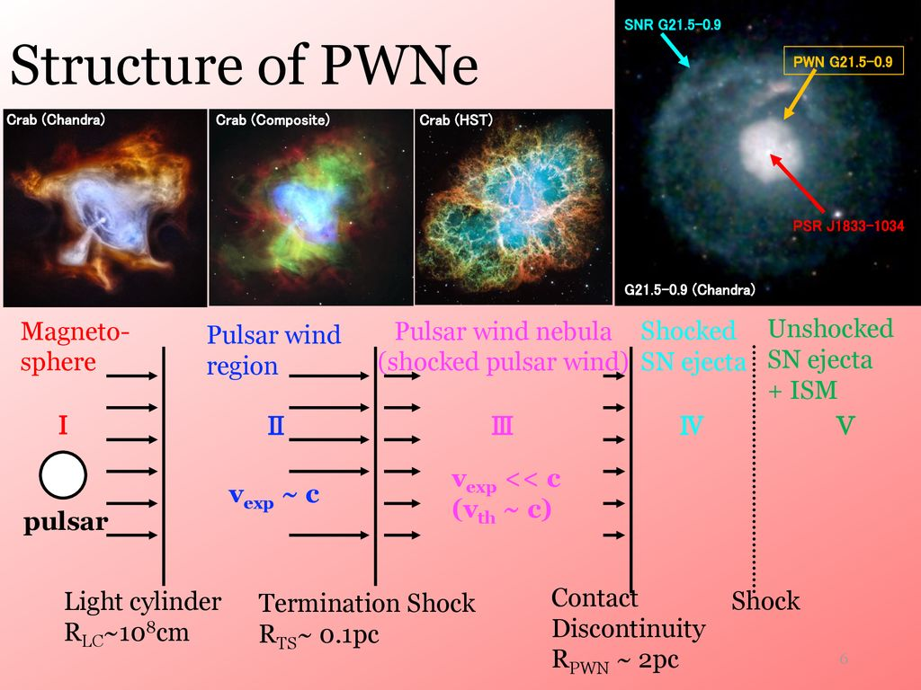
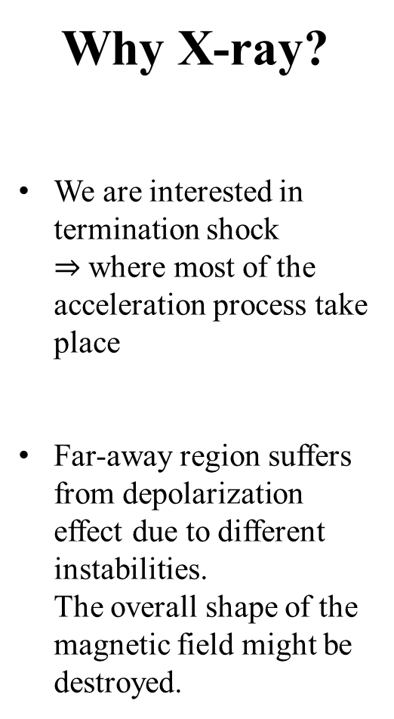
Why X-ray?
We are interested in termination shock
$⇒$ where most of the acceleration process take place
Far-away region suffers from depolarization effect due to different instabilities.
The overall shape of the magnetic field might be destroyed.

Slide 4
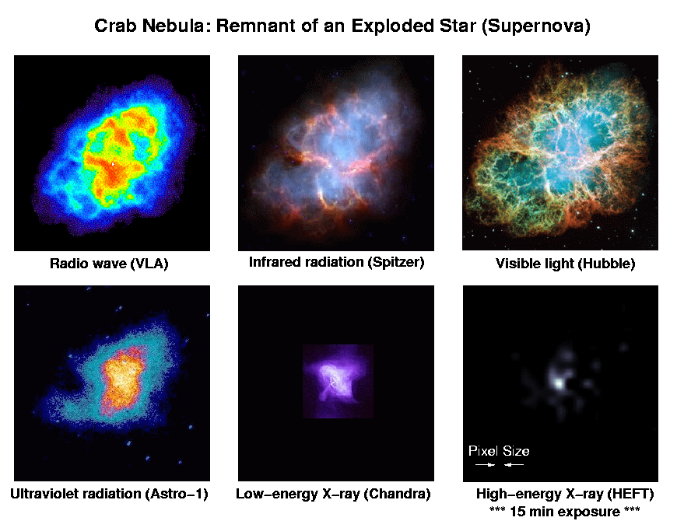
The Crab Pulsar Wind Nebula
Radio:
Most of the signal comes from the outer region
Contamination from Faraday rotation
Contamination from the pulsar
Optical:
Contamination from the foreground
Most of the PWN does not have optical observation, but Crab nebula has!

Slide 5
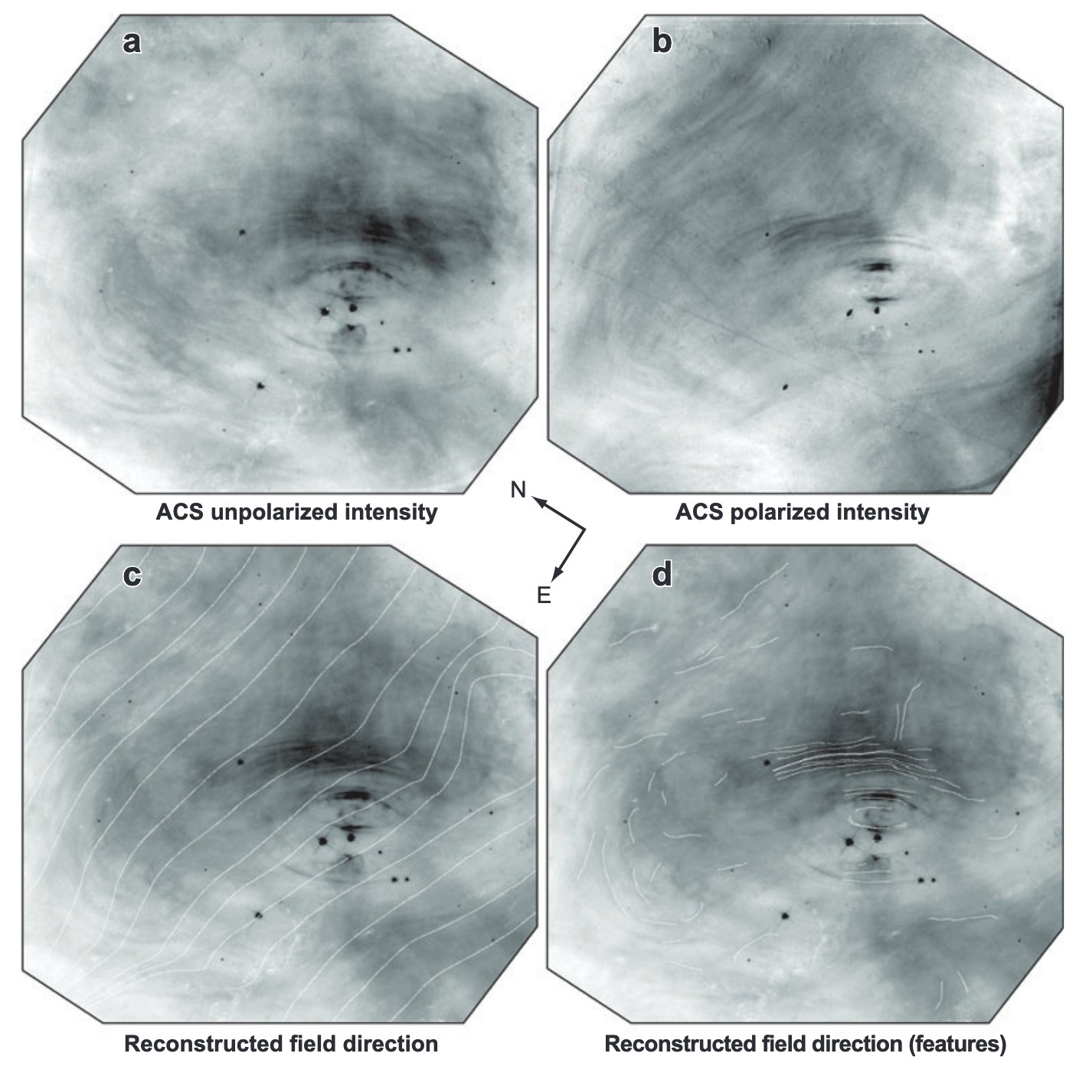
The Magnetic Field
The overall shape of magnetic field is toroidal.

Slide 6
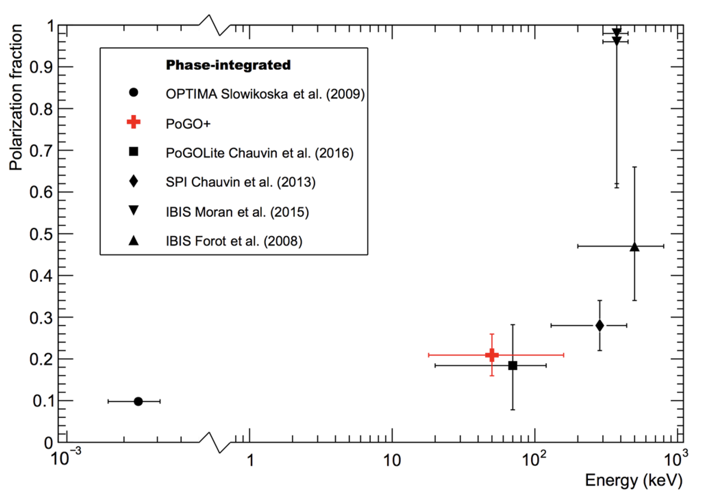
Previous Detections
The Known phase-integrated polarimetric studies of the Crab.
AstroSat Vadawale et al. (2018)
(M. Chauvin et al. 2017)

Slide 7
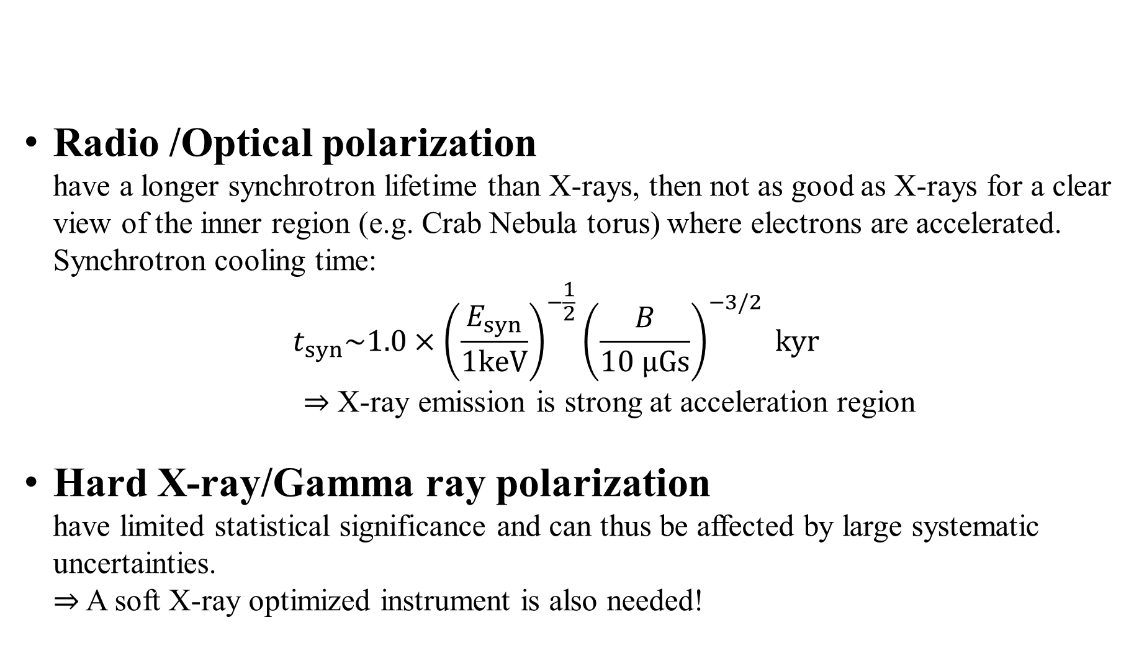
Why polarLight?
Radio /Optical polarization
have a longer synchrotron lifetime than X-rays, then not as good as X-rays for a clear view of the inner region (e.g. Crab Nebula torus) where electrons are accelerated.
Synchrotron cooling time:
$t_{syn}\sim 1.0×{\left(\frac{E_{syn}}{1keV}\right)}^{−\frac{1}{2}}{\left(\frac{B}{10 μGs}\right)}^{−3/2} kyr$
$⇒$ X-ray emission is strong at acceleration region
Hard X-ray/Gamma ray polarization
have limited statistical significance and can thus be affected by large systematic uncertainties.
$⇒$ A soft X-ray optimized instrument is also needed!

Slide 8
Missing Component : Turbulence
Hard to resolve but large to affect emission
Lower front-to-sides brightness difference
Depolarize
(Bucciantini et al 2017: Subgrid effect)

Slide 9
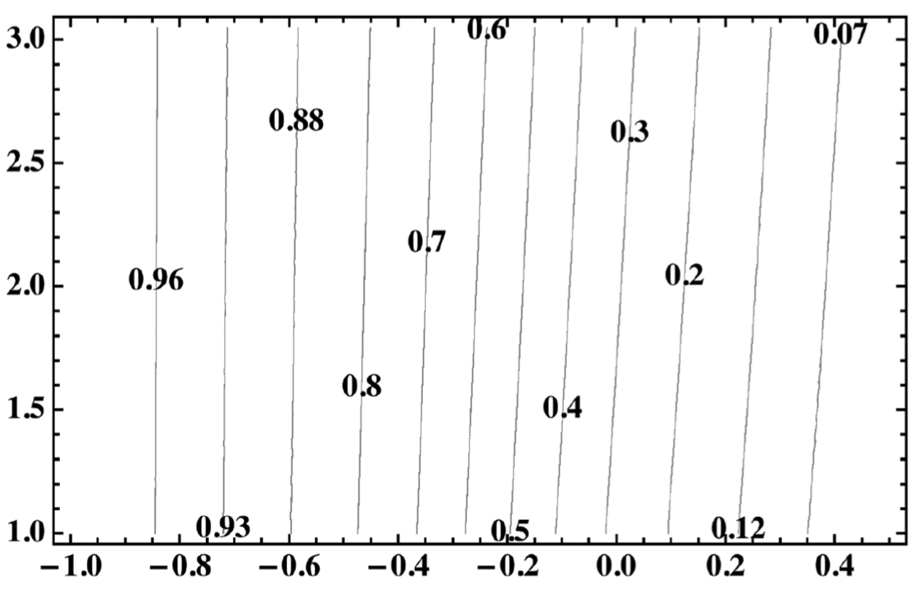
One possible analytical model for turbulent component
Assume that the small-scale fluctuation can be described by an isotropic random Gaussian field and electrons have a power-law energy distribution.
Polarization fraction weakly depends on s
s : Slope of the power law
₁F₁ : Kummer confluent hypergeometric function
(Bandiera R., Petruk O., 2016)

Slide 10
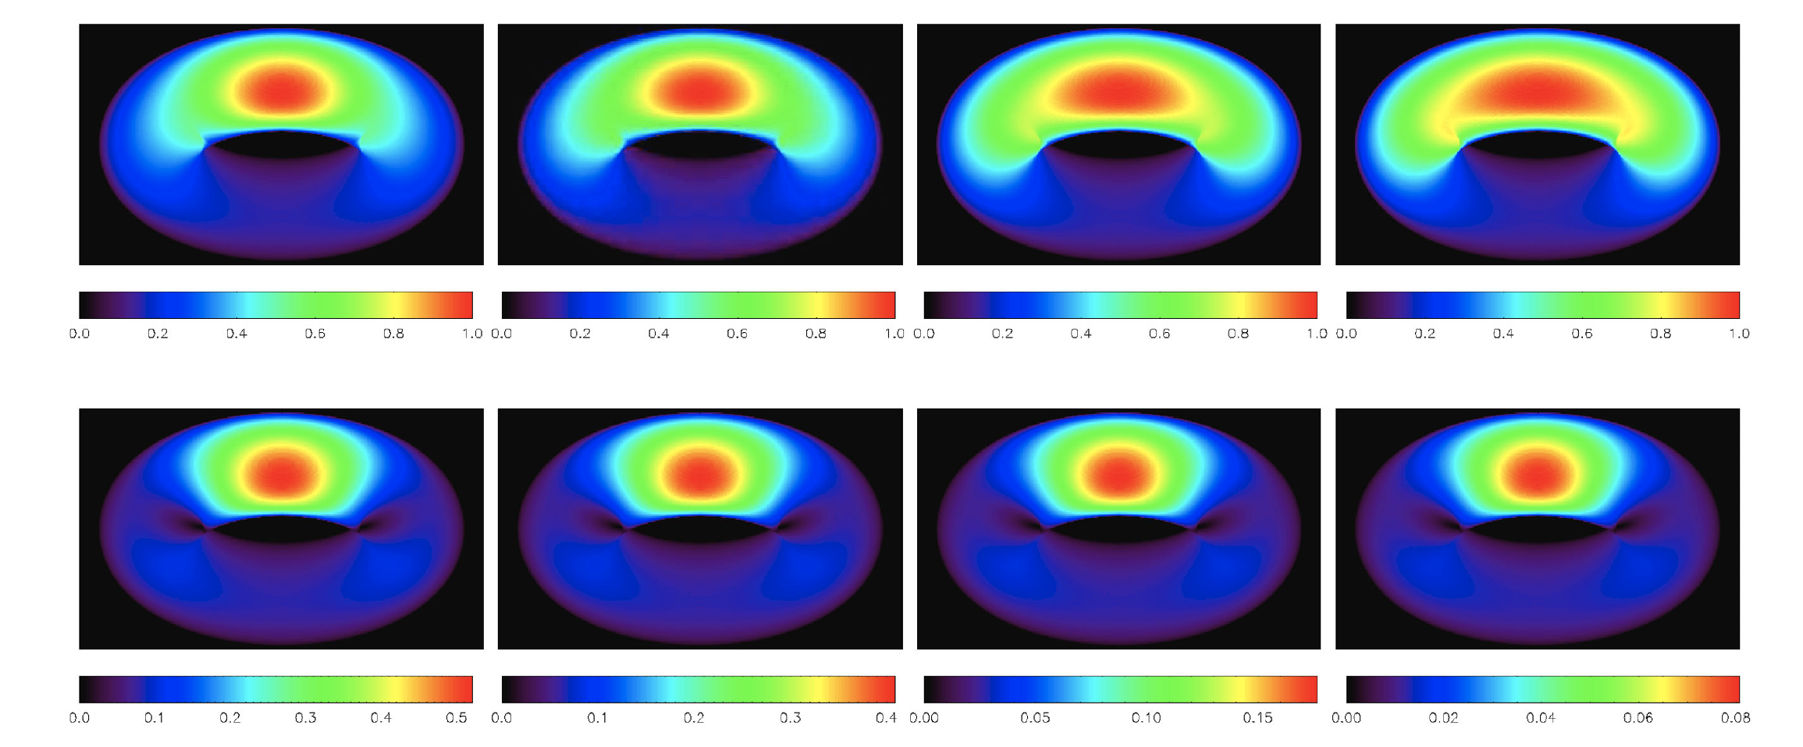
Missing Component : Turbulence
PF = 17%±2%
Consistent with Weisskopf et al (1978)
Total
Polarized
(Bucciantini et al 2017)

Slide 11
Missing Component : Turbulence

Slide 12
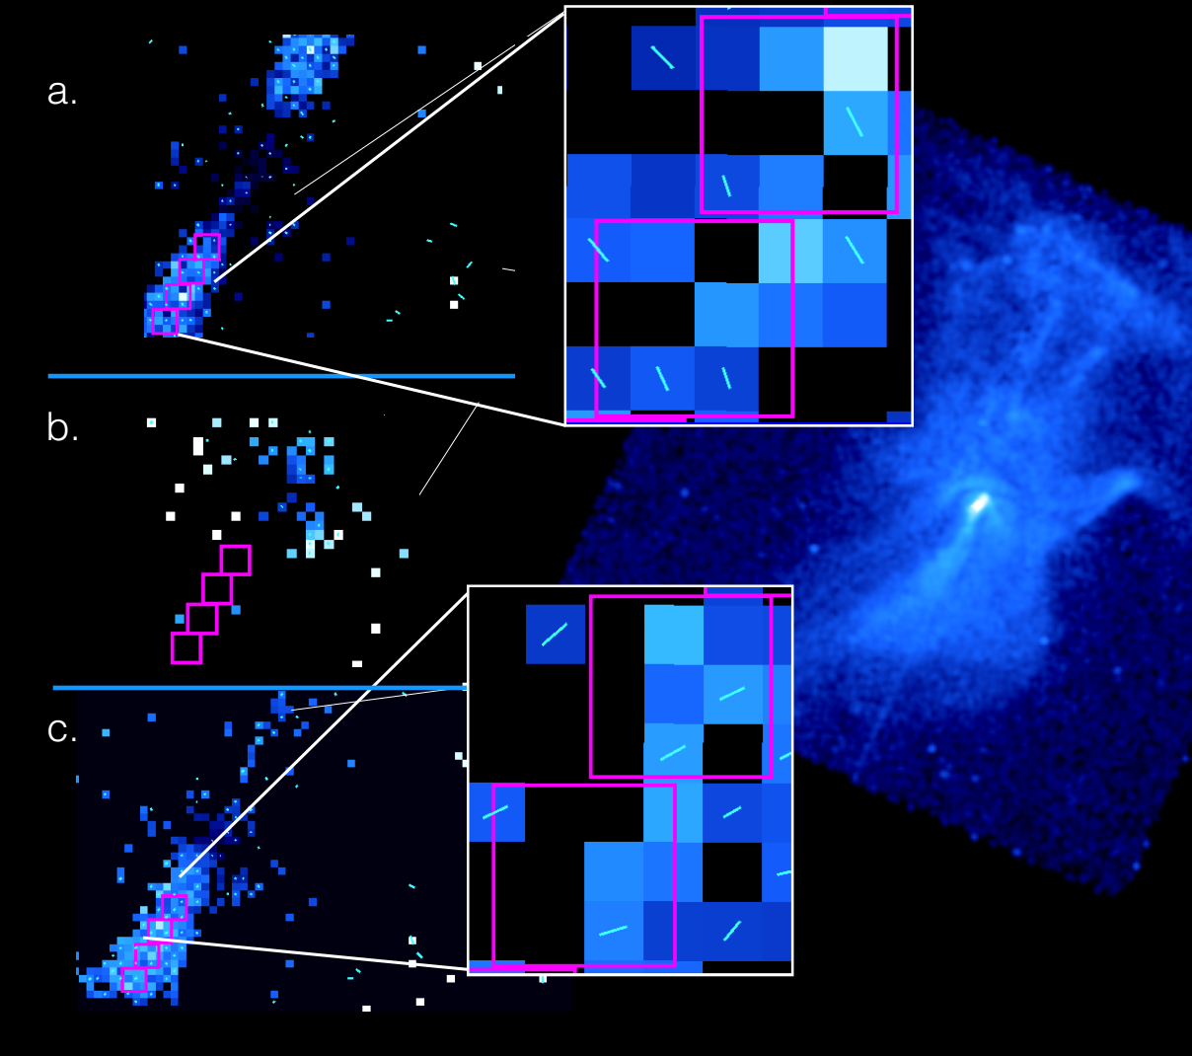
Spatial Resolved
X-ray Polarization
Science:
Extend the detected magnetic field configuration/ordered-disordered ratio to the inner region.
Reveal the particle acceleration mechanism.
Identify possible spatial variation of acceleration mechanism.
Challenging for instrument:
Better spatial resolution – impossible for polar-light。
Longer integration detection time。
PWN MSH 15-52
(Wilhelmi+ 2016)

Slide 13
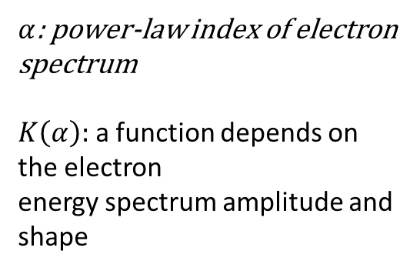
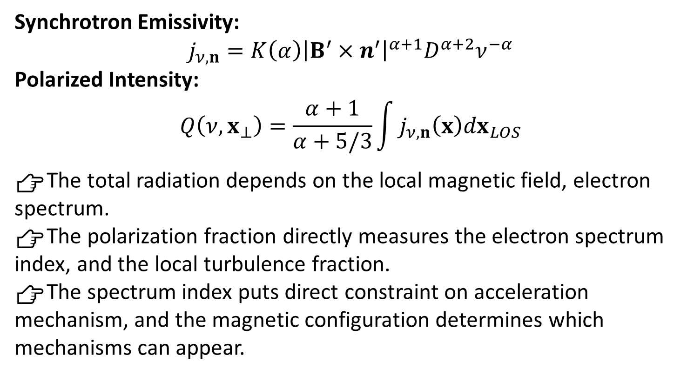
What can be learnt from spatial Resolved X-ray Polarization
Synchrotron Emissivity:
$$j_{ν,n}=K\left(α\right){\left|B^{′}×n^{′}\right|}^{α+1}D^{α+2}ν^{−α}$$
Polarized Intensity:
$$Q\left(ν,x_{⊥}\right)=\frac{α+1}{α+5/3}\int{j_{ν,n}\left(x\right)dx_{LOS}}$$
👉The total radiation depends on the local magnetic field, electron spectrum.
👉The polarization fraction directly measures the electron spectrum index, and the local turbulence fraction.
👉The spectrum index puts direct constraint on acceleration mechanism, and the magnetic configuration determines which mechanisms can appear.
$α$: power-law index of electron spectrum
$K\left(α\right):$ a function depends on the electron
energy spectrum amplitude and shape
PWN MSH 15-52
(Wilhelmi+ 2016)
(Bucciantini et al 2017)

Slide 14
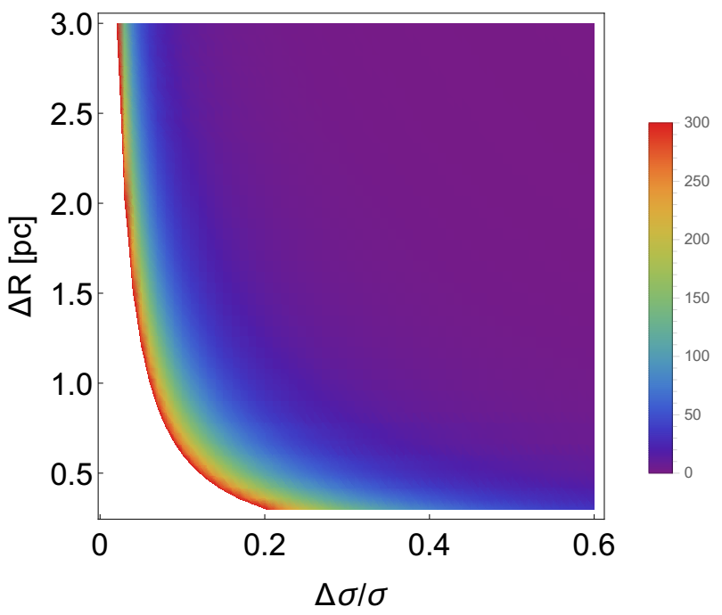
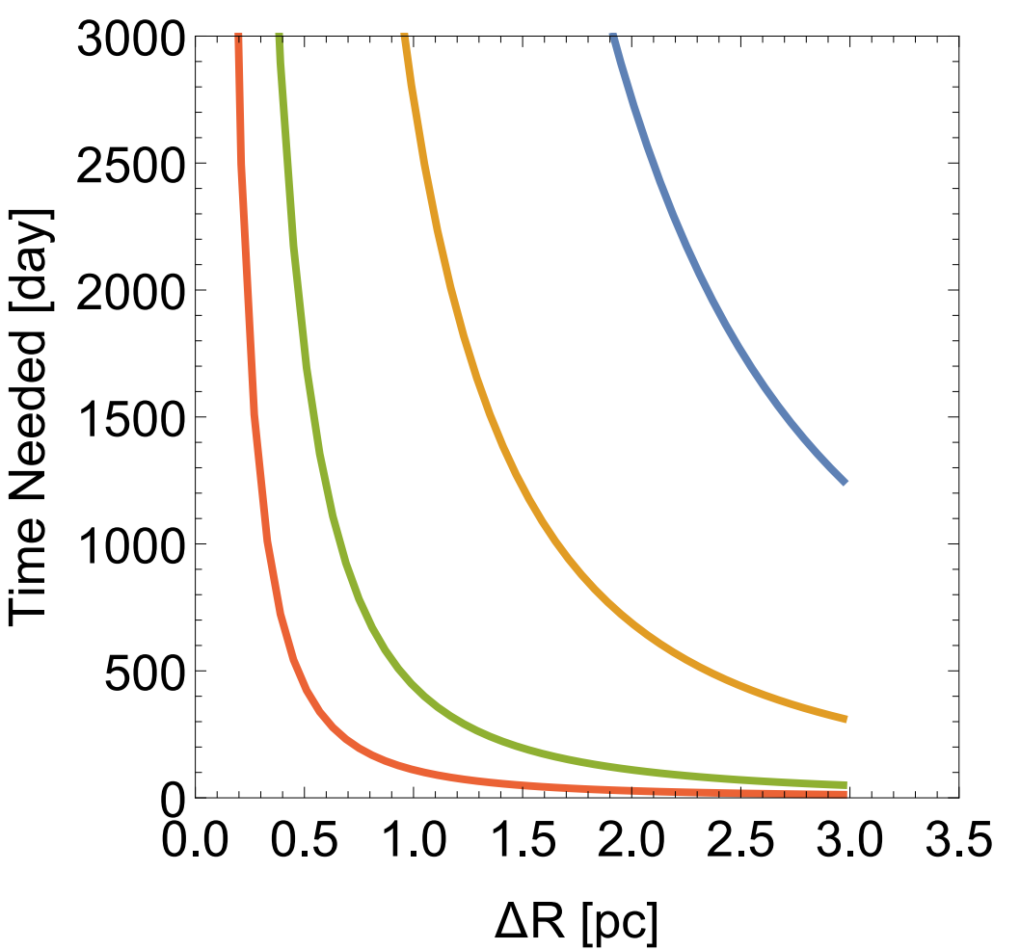
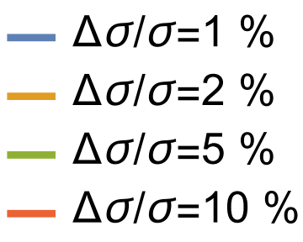

Prediction of observation time
Time Needed [day]
Turbulence Fraction $3σ^{2}=\frac{δE}{E}$

Slide 15
Summary: Polarization Detection of Crab PWN by Polar-Light
X-ray polarization is a direct and clean probe to the magnetic field in PWNs.
Polar-Light will enable us to probe the soft X-ray polarization.
Total polarization provides rough constraint of fractions of magnetic field components.
Spatial resolved X-ray polarization is not available yet but useful and promising in the future.

