Slide 1
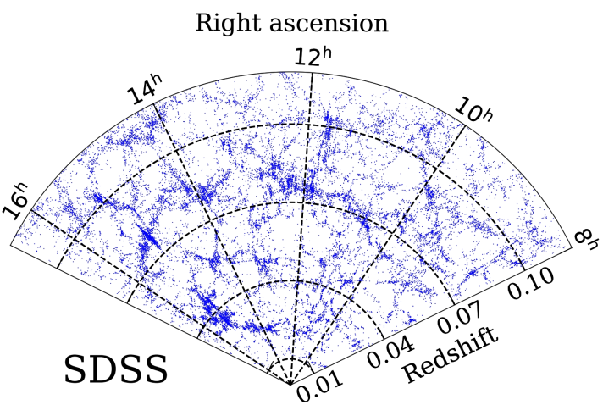
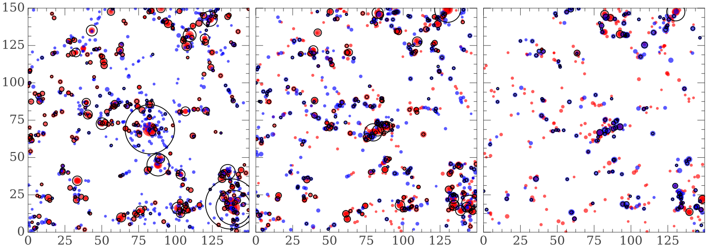
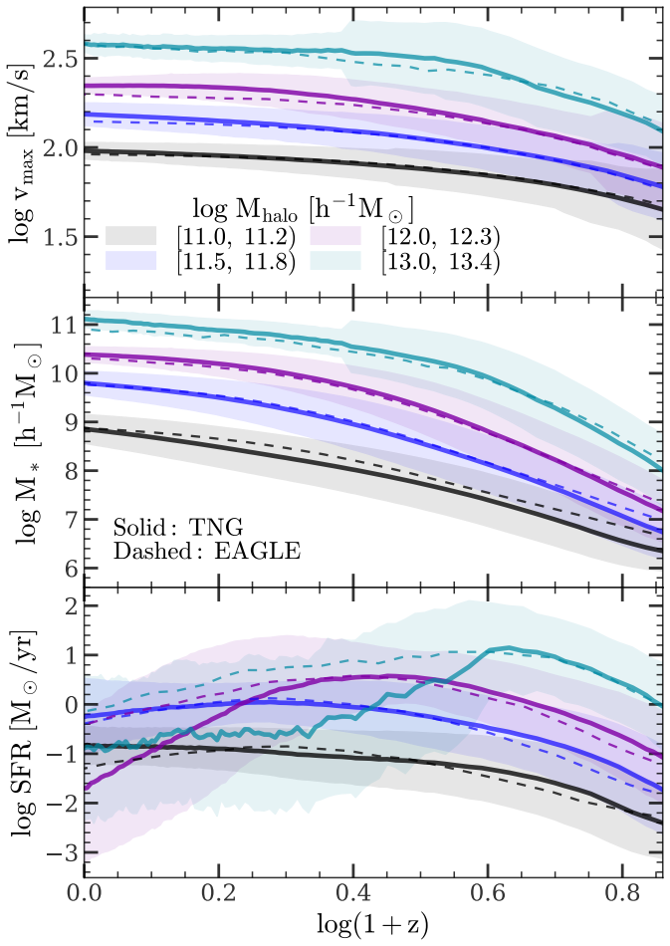
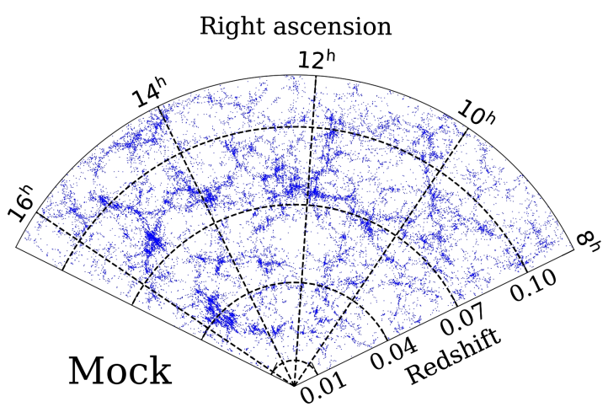
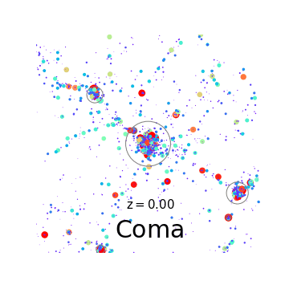
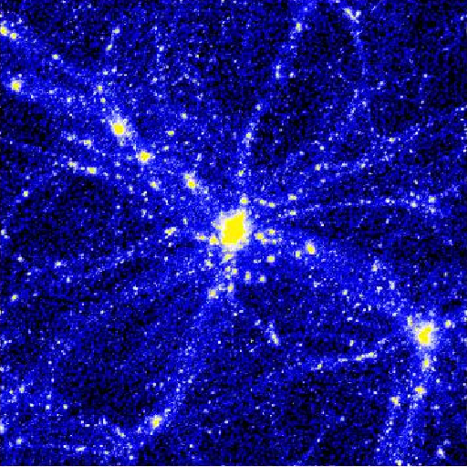
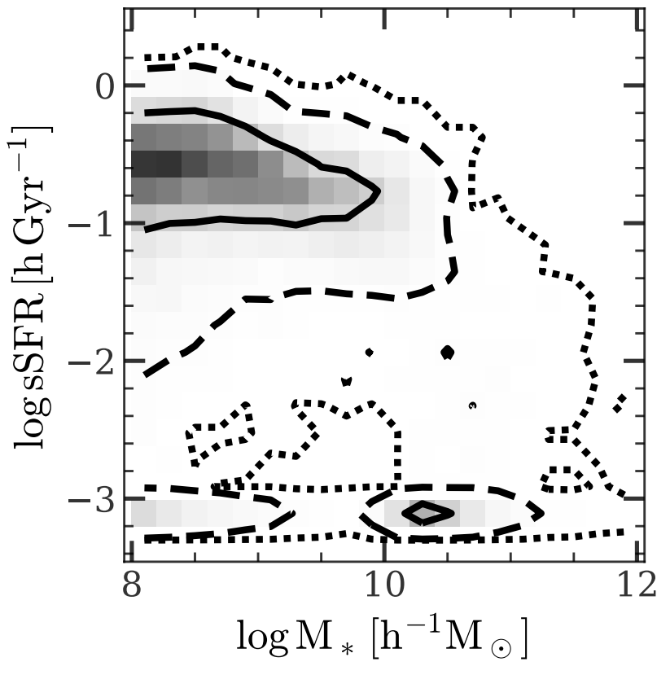
Empirical Model of Galaxy Star Formation in Dark Matter Halos
Galaxy spatial distribution
Yangyao Chen
Galaxy evolution on the cosmic web
A
Assembly history
D
C
Formation of massive clusters
E
Galaxy stellar mass, colors, ...
B
$$40 h^{−1}Mpc$$
Other interests:
Parallel computation (algorithms, data/instruction/thread/proc-level ...)
Modern statistical learning (Bayesian nets, Deep NNs, ...)
Email: yangyaochen.astro@foxmail.com
https://www.chenyangyao.com
A - Chen+ 2019 (arXiv:1809.00523)
B, C - TNG & EAGLE hydro simulation
D, E - Chen+ 2020 (arXiv:2003.05137) & in-prep

