Slide 1
Arxiv: 1908.07547
Yangyao CHEN
cyy12345678@163.com

Slide 2
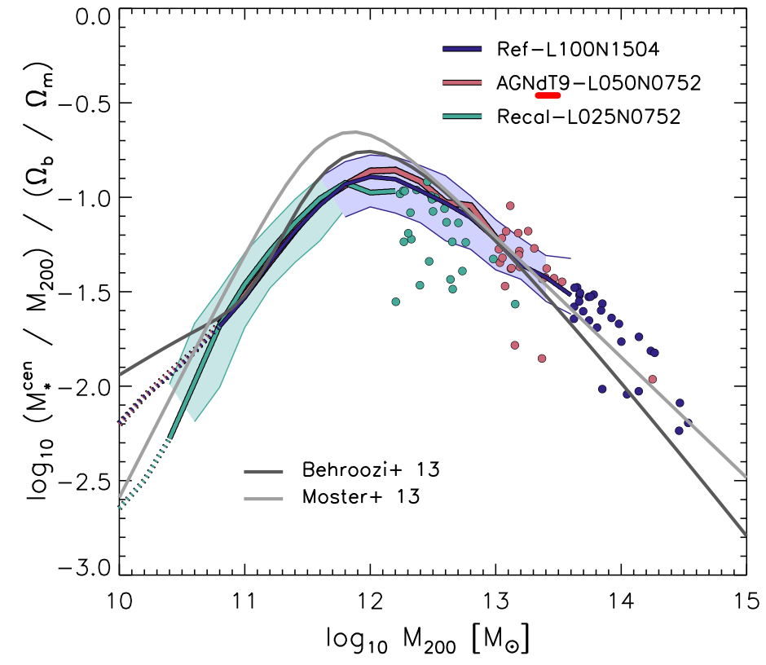
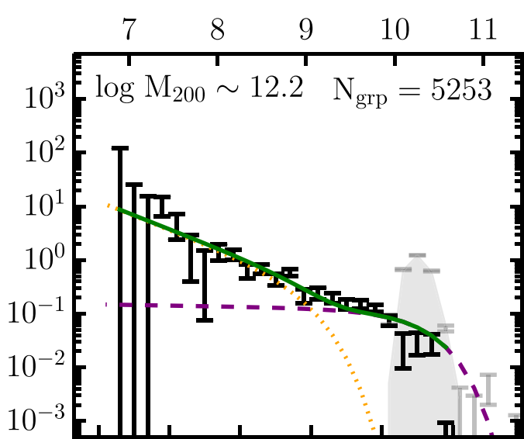
Background
Galaxy-halo Connection
Pillepich A. 2018 (TNG)
$$dN/dM_{r}$$
$$M_{r} [mag]$$
Schaye J. 2014 (Eagle)
Lan T.-W. 2016

Slide 3
Background
Approaches to Find Galaxy-Halo Connection
Galaxy clustering
assembly history/assembly bias on galaxy – halo connection $⇒$ systematic errors
Galaxy-galaxy lensing
Need stack method, accurate photometry, non-trivial shear measurement
Galaxy Group Finder
Subtle stellar mass calibration
Traditional Satellite Kinematics
Need stack method / summary statistics (mass-mixing; ignore fruitful phase space info; velocity bias)
Anisotropic satellite orbit
Sample selection effect / incompleteness
Interlopers / impurity of central determination
Arxiv: 1908.07547

Slide 4
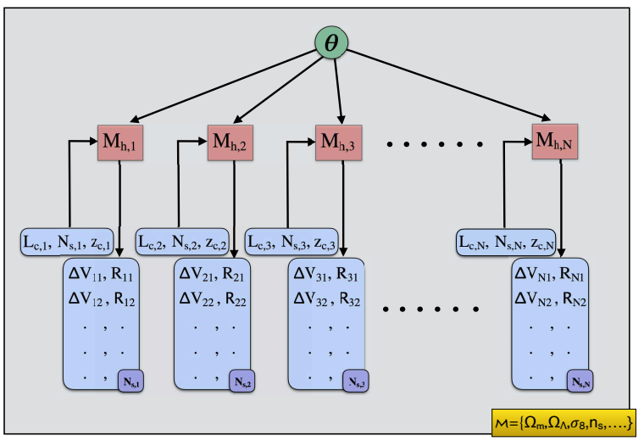
Method
Forward Bayesian Modelling
Two Keys: Bayesian + Hierarchical
Bayes approach allows forward modelling (capture the causality), cooperating with prior knowledge, and full posterior with statistical meaning
Hierarchical approach helps to construct any complex model using simple modes (Theory: two layer network + simple exp-family dist. $⇒$ any distribution desired at any precision)
Satellite Kinematics Sub-model
Finally, use MCMC to sample the posterior
Halo Occupation Sub-model
Observables +
Central and satellite identification
(similar to the group finders)

Slide 5
Method
Forward Bayesian Modelling
$$θ$$
$$θ$$
Satellite Kinematics Sub-model
Halo Occupation Sub-model
Observables +
Central and satellite identification
(similar to the group finders)

Slide 6
Method
Sub-model I. Halo Occupation
Parametric form
of conditional lumin function for satellite
+ Possion sampling
+ Interlopers modelling
$$θ$$
Hierarchical in
hierarchical
$$θ$$
Halo Occupation Sub-Model
Survey incompleteness
Parametric form
of conditional lumin function for central
Halo Mass Function from N-body

Slide 7
Method
Sub-model II. Satellite Kinematics
$$θ$$
$$θ$$
Uniform Distribution in $\left(ΔV,R_{p}\right)$ space
Satellite Kinematics Sub-model
Modified NFW
+ Jeans equation derived radius $σ_{r}^{2}$
+ Parametric form of trajectory anisotropy

Slide 8
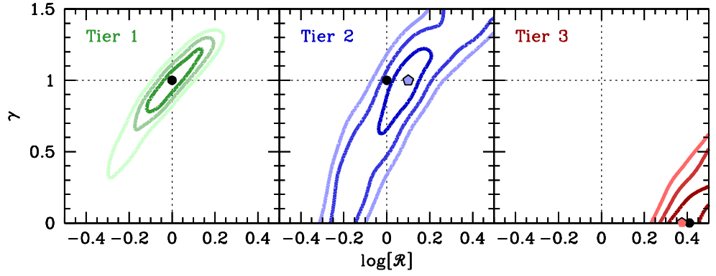
Validation
Three-level Validations
Test with mock catalogs, with increasing complexity
Level-1 (idealized mocks) halo mass function + $L_{min}(z_{c})$ + conditional luminosity functions of central and satellite + gNFW + no galaxy bias (w.r.t. halo density) + no other observation selection
Level-2: Simulated halos (ROCKSTAR) + $L_{min}(z_{c})$ + CLFs (halotools) + gNFW + galaxy bias + fiber collision + redshift error
Level-3: Simulated halos (ROCKSTAR) + $L_{min}(z_{c})$ + CLFs + Subhalos +fiber collision + redshift error
Posterior:

Slide 9
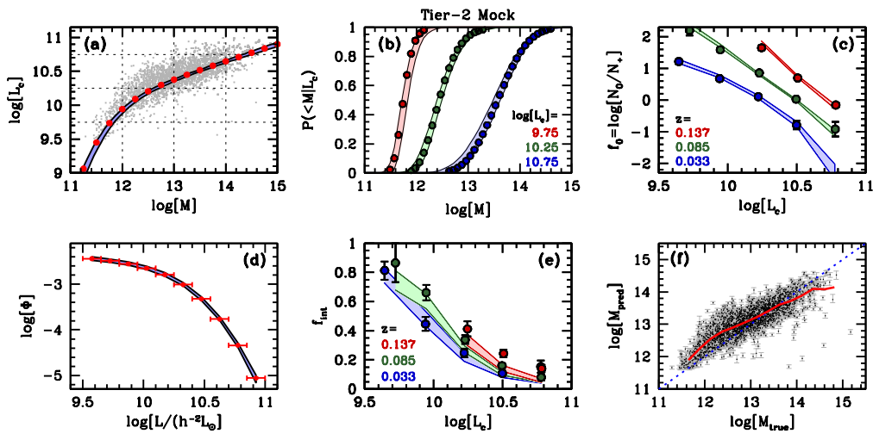
Validation
Three-level Validations
Prediction with parameter posterior from level-2 mock:
uniform dist. of interlopers
may wrong
<halo to halo $σ$> = 0.35 dex
<bias> = 0.15 dex

Slide 10
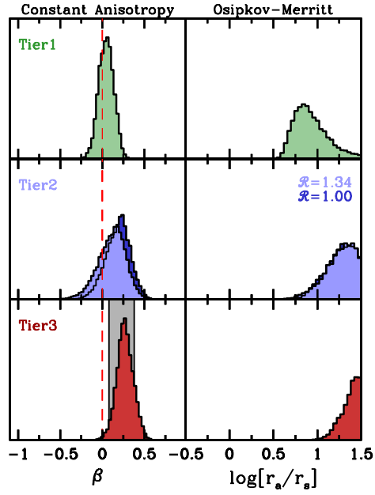
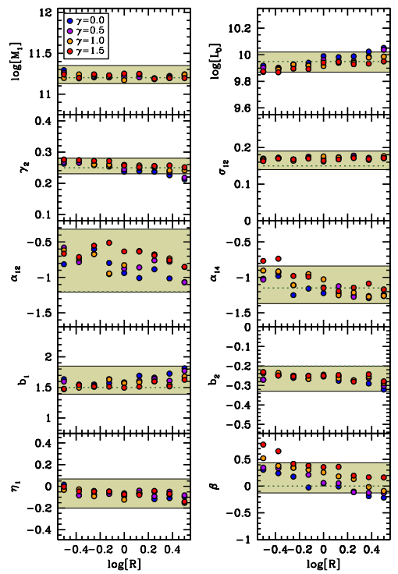
Validation
Advantages of This Work
Kinematics Anisotropy Parameters
modified NFW parameters

Slide 11
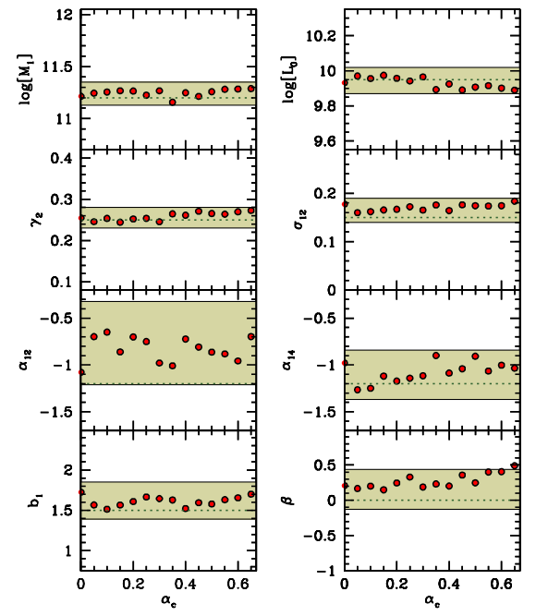
Validation
Advantages of This Work
Kinematics Anisotropy Parameters
Velocity bias parameters

Slide 12
Summary
Approaches to Find Galaxy-Halo Connection
Galaxy clustering
assembly history/assembly bias on galaxy – halo connection $⇒$ systematic errors
Galaxy-galaxy lensing
Need stack method, accurate photometry, non-trivial shear measurement
Galaxy Group Finder
Subtle stellar mass calibration
Traditional Satellite Kinematics
Need stack method / summary statistics (mass-mixing; ignore fruitful phase space info; velocity bias)
Anisotropic satellite orbit
Sample selection effect / incompleteness
Interlopers / impurity of central determination
Arxiv: 1908.07547

